Slide 1
MY FIRST EXPERIENCE IN NAIROBI

Slide 2
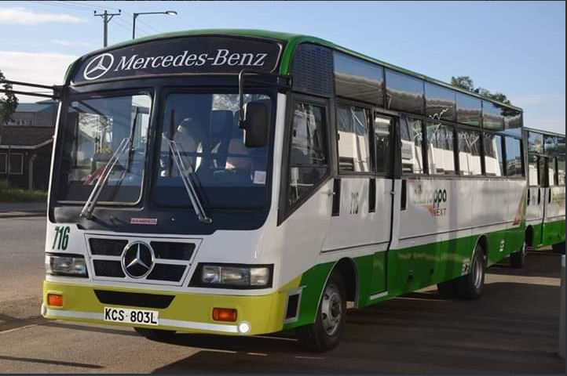
Boarding a bus from the stage some even going to an extent of installing complimentary wIFI

Slide 3
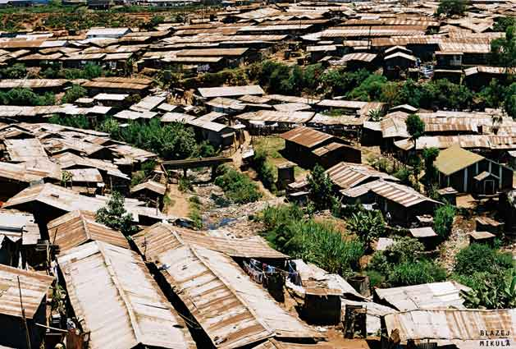
Viewing kibera the largest urban slums in Africa

Slide 4
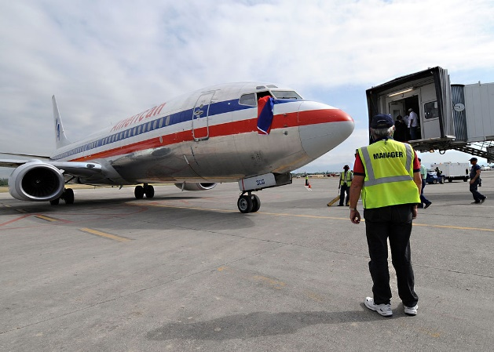
Jommo Kenyatta international air port which is the largest air port in Kenya

Slide 5
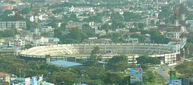
Nyayo national stadium second largest stadium in kenya

Slide 6
Interacting with people from different communities.

